Slide 1
Centralized Medical Record System using RFID & Blockchain
Pranav Viswanathan 20BPS1106
Ajith Suresh 20BPS1064
Sanjay Suresh 20BPS1024
Athul Ravi 20BPS1029

Slide 2
AGENDA
Problem Identification
Motivation
Plan for Collection of Data
Plan & Process Involved
Expected Outcome

Slide 3
Problem Identification
The healthcare industry is a vital existence in any country. However, it has come to our notice that there are a few areas where improvements can be made, or maybe even completely overhauled.
In case of any accidents, victims are handled by first responders (first aid) or if at a hospital, the emergency department. The treatment provided here is to stabilize the victim enough to proceed with further treatment, however, there are chances that said victim may have an allergic reaction to the substance being used. This further endangers the victim, instead of stabilizing them.
Patients who consult multiple doctors from different hospitals have individual files in their name at each of those hospitals. None of the visited hospitals have the patient’s complete medical history, which in cases can provide extra insight to the doctors regarding the patient’s treatment plan.

Slide 4
MOtivation
It came to our notice how provision of information as important as allergies could potentially help victims when first aid is being performed on them. If all it takes to help a first responder keep the patient’s condition stable is that little bit of information, we felt it should be readily accessible.
When we visit a health facility for the first time, we are asked to fill forms to enable creation of a new local file there. Though not too time consuming, it is a repetitive task, having to fill the same details again and again each time you have to visit a new hospital. We figured this is something to fix.
Again, each hospital you visit has their own file about you and your medical history as far as that hospital knows. At no one place do you get your entire medical history. We thought this should be something to consider as well.

Slide 5
Plan for Data collection
Centralized Medical Record System using RFID & Blockchain
Considering patients who are of old age, or with memory problems, it is difficult for them to write their details every time they visit the hospital, so each person will be given a serial number. This serial number can be used to access the medical records of that specific patient
This serial number is encoded and kept inside an RFID tag.
Each time they visit the hospital, using an RFID scanner, the encoded serial number is read and its corresponding medical records is made visible to the hospital making it a very easy and time-saving process.

Slide 6
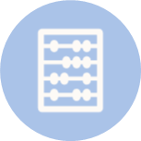
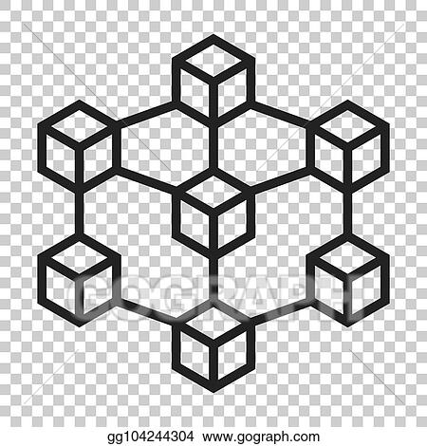
Plan & Process Involved
Project Asclepius
Project Mnemosyne
Vital information regarding the patient like blood type and medicine allergies will be provided on the wearable band.
This will supplement the data already available on the band worn by the patient.
The consolidated medical records will be stored on the blockchain, and will be accessible when the wearable band is scanned by an authorized access point to keep data safe.

Slide 7
Expected outcomes
Allowing first responders to immediately access critical health-related essential information by simply scanning the RFID found on the person
Facilitating easy and seamless transfer of information and medical records when shifting from one hospital to another ensuring that there are no gaps in medical history
Using blockchain based technology and RSA authentication to make the whole process secure and safe
Allowing the auto-filling of information for medical forms and documents simply by scanning the RFID

Slide 8
THANK YOU

